Slide 1
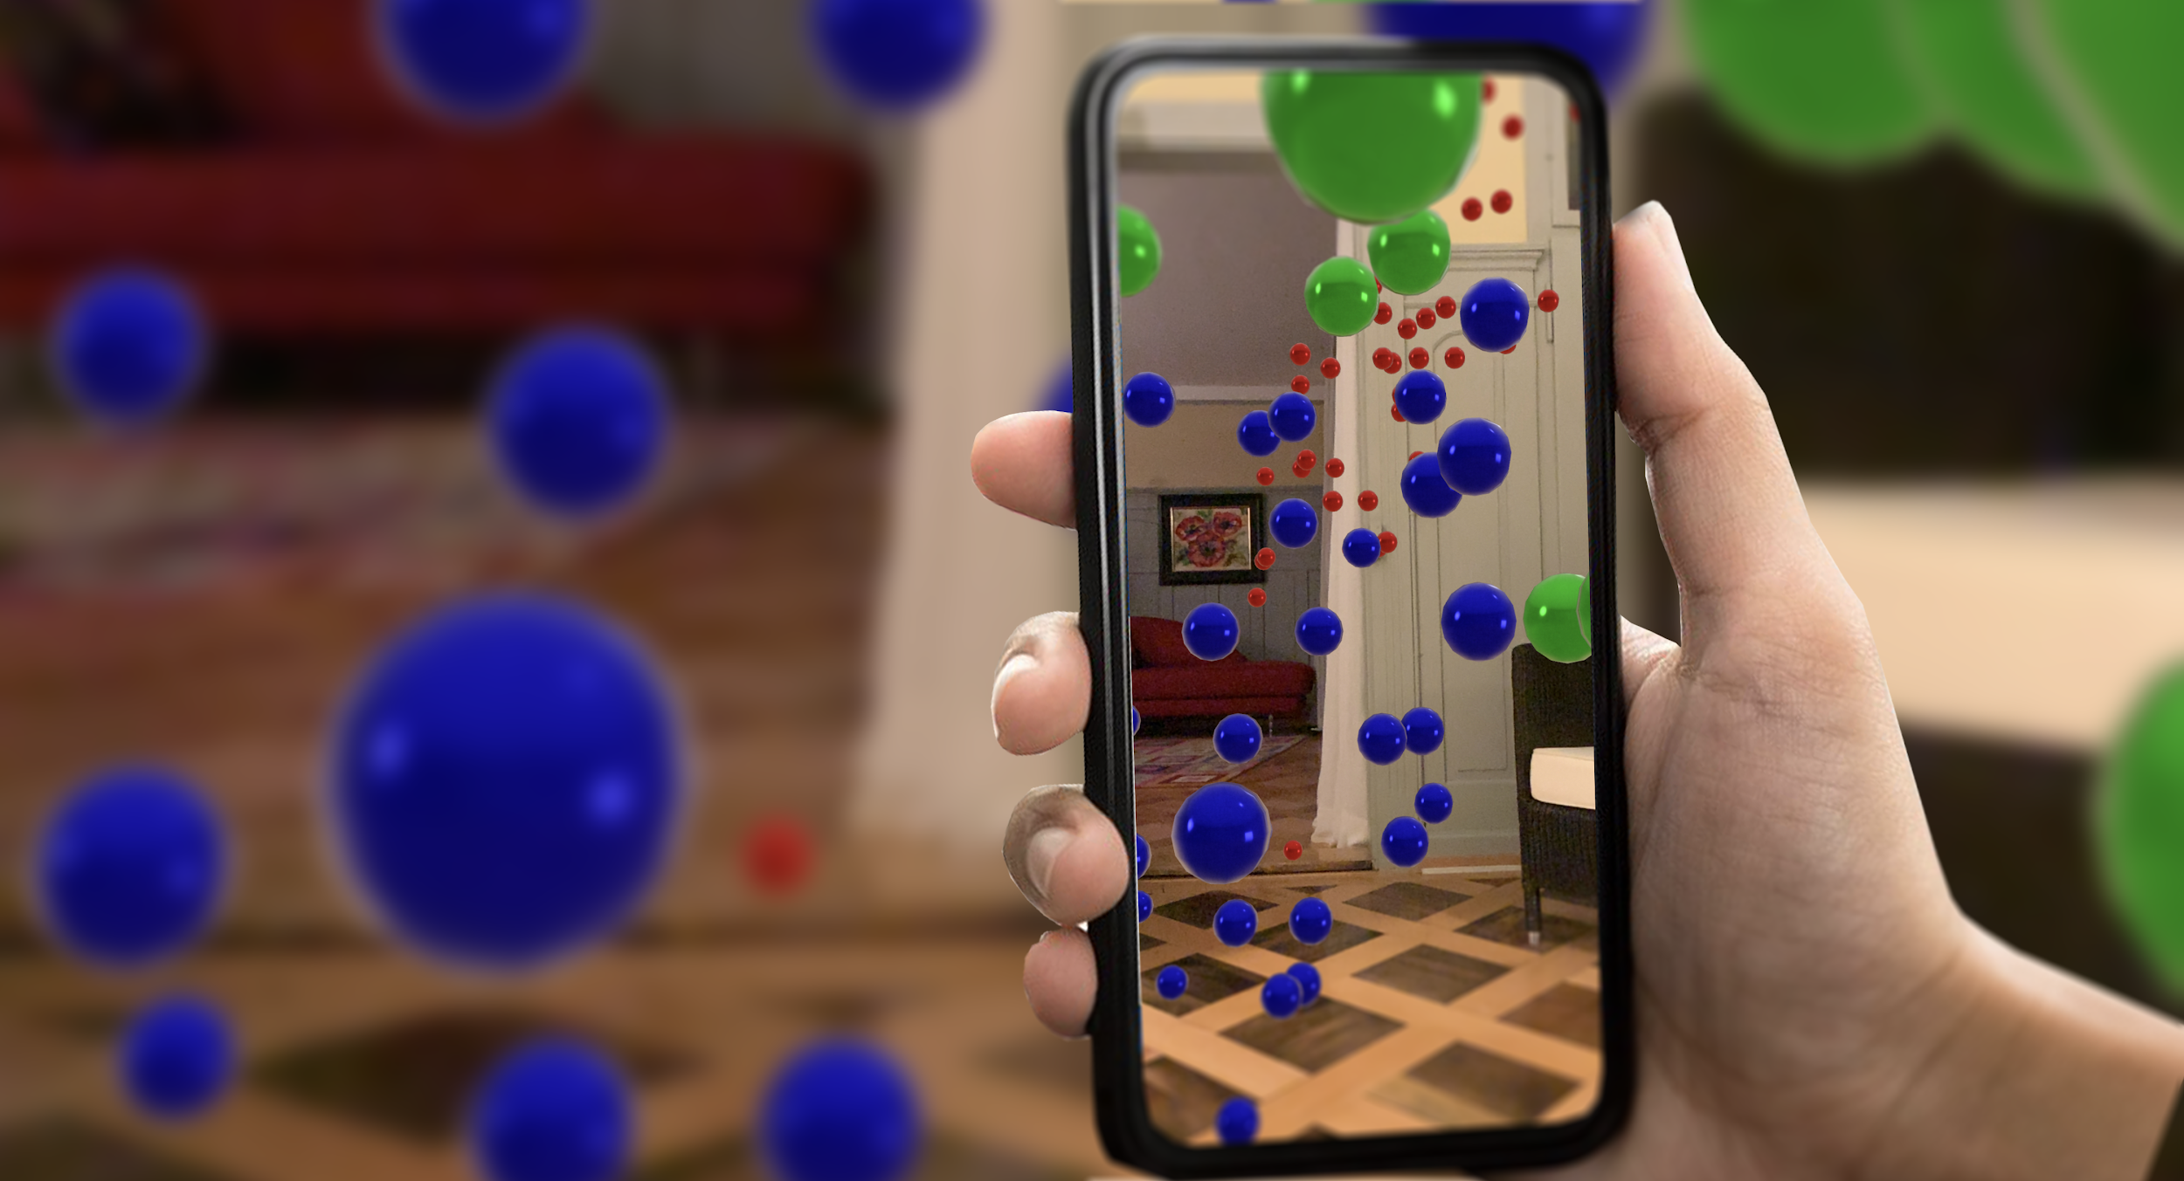




plotAR - walk through your data
Phillipp Thomann
Managing Consultat, D ONE
@thomann
@DrThomann
useR! 08.07.2021

Slide 2
About me
Vita
PhD in Probability Theory @ Zurich University
PostDoc in ML @ Stuttgart University
Managing Consultant @ D ONE Solutions
Projects in Data Science, ML, AI, Infrastructure, Visualisation, Coaching
(Co-)Creator of
liquidSVM - A fast and versatile SVM implementation
Nabu - vocabulary drilling tool
NLPeasy - Easy Peasy Language Squeezy
plotAR - walk through your data

Slide 3
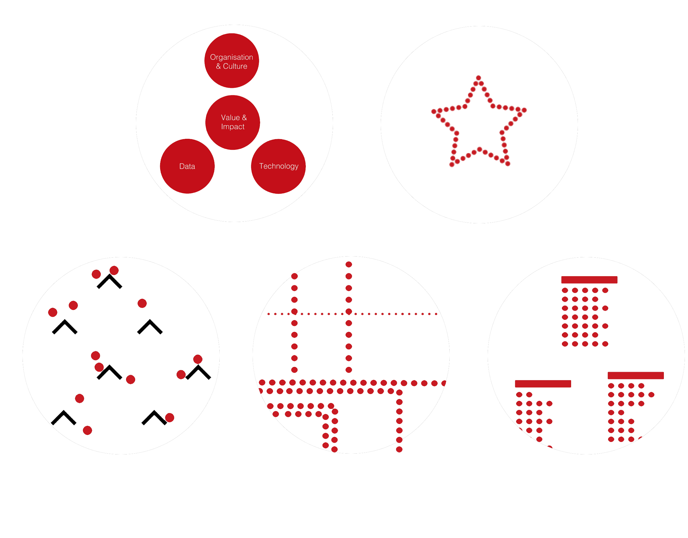
Value Creation & Capabilities
Organisation & Culture
Business Consulting
- Guide on data journey
- Use cases, roadmap
- Transformation and change
- Building capabilities
Machine Learning / AI - Ideation, implementation - Algorithms, modelling, NLP - Image recognition - Text analytics
Business Value
Data Architecture
- Data strategy
- Enterprise requirements
- Information factory
- BI and analytics
- Data science laboratory
Data
Technology
Data Management
- Data supply chain
- Data integration and modelling
- Structured & unstructured data
- Automated development framework
Data Experience
- From data to Insights to action
- Business report design
- Compelling data stories
- Communication & visualization
Notes:
Our focus point: Data driven business value generation
3 Pillars we cover well.
Data run on platform, tooling, architecture
Usage of data: -> change in organisation & culture, maybe renewal required -> change management
Business Consulting: Consulting & Delivery combined
To achieve that: 3 central aspects
Organisation & Culture: Industry, Strategy, Capabilities, Innovation, Legislation, Stakeholder Roles & Responsibilities & Needs, Processes & Collaboration
Technology: Enterprise Landscape & Requirements, Architecture, Budget?
Data: Volume, Variety, Veracity and Velocity of Data, Data Sources and Flows
We support by:
Business Consulting
Data Architecture
Data Management
ML / AI
Data Experience

Slide 4
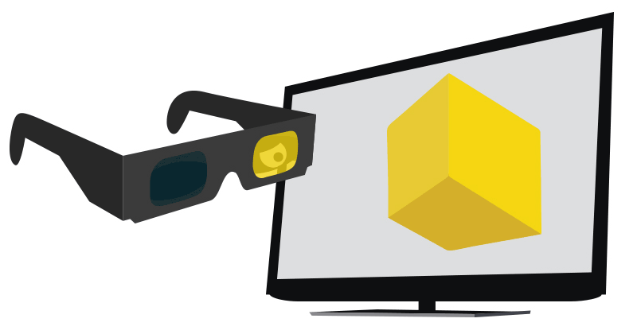
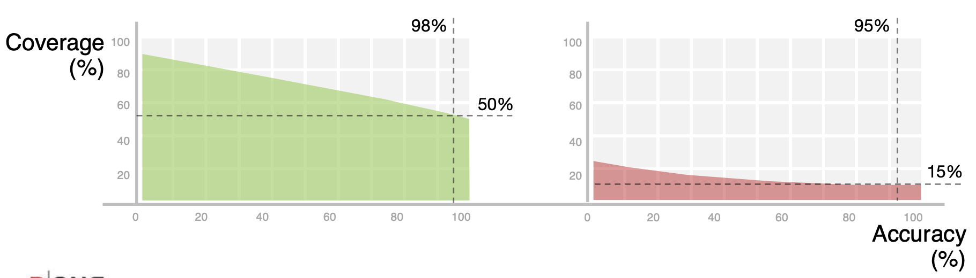
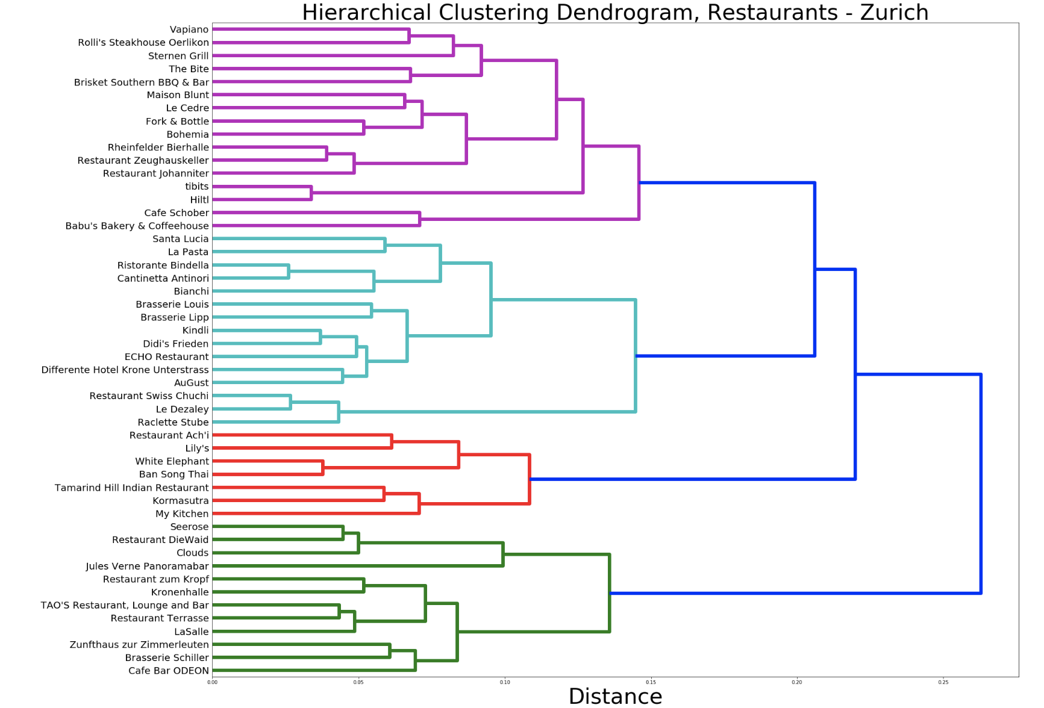
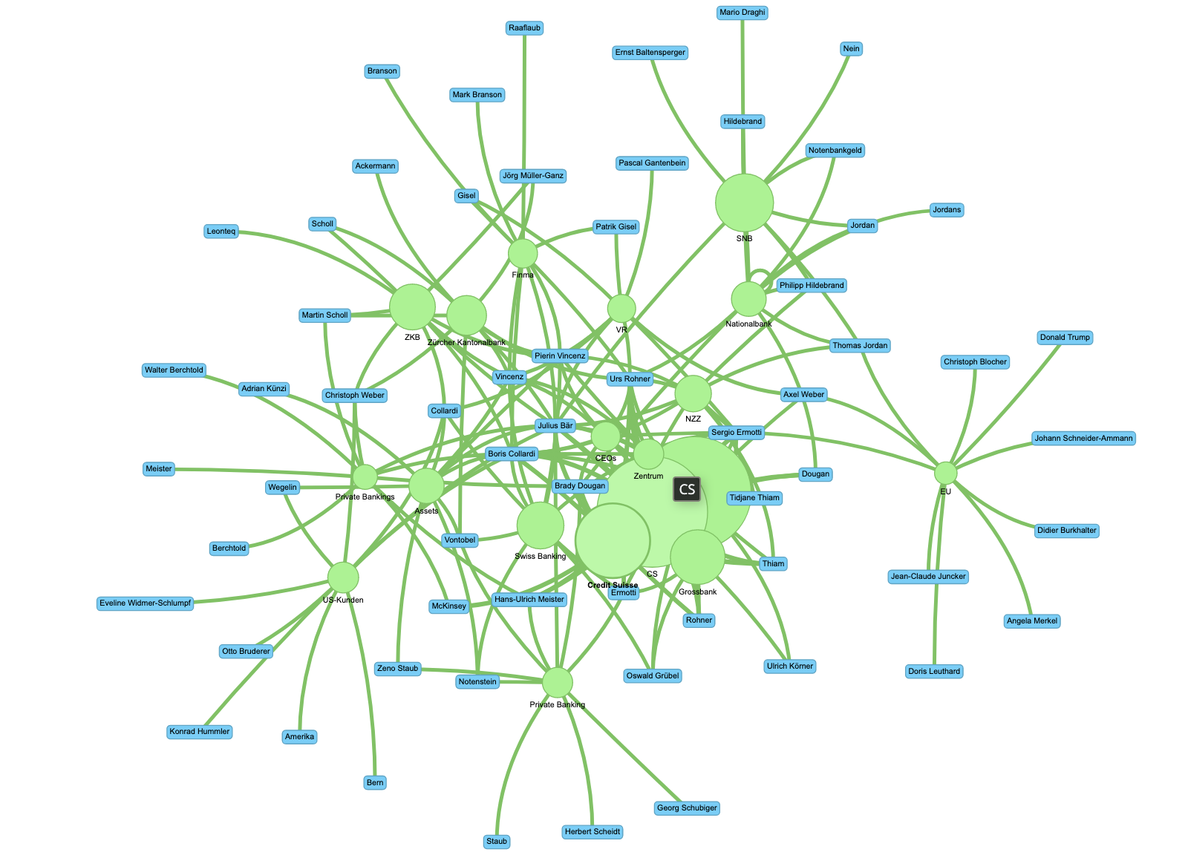
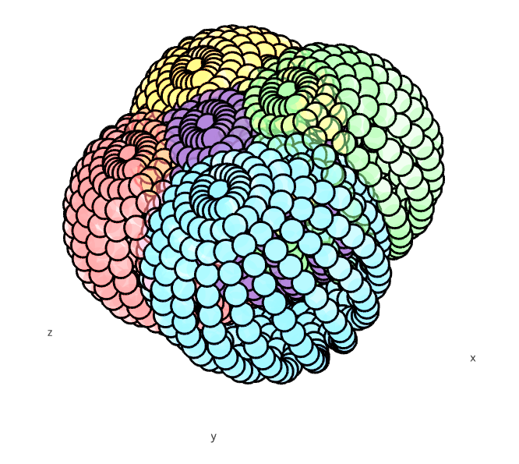
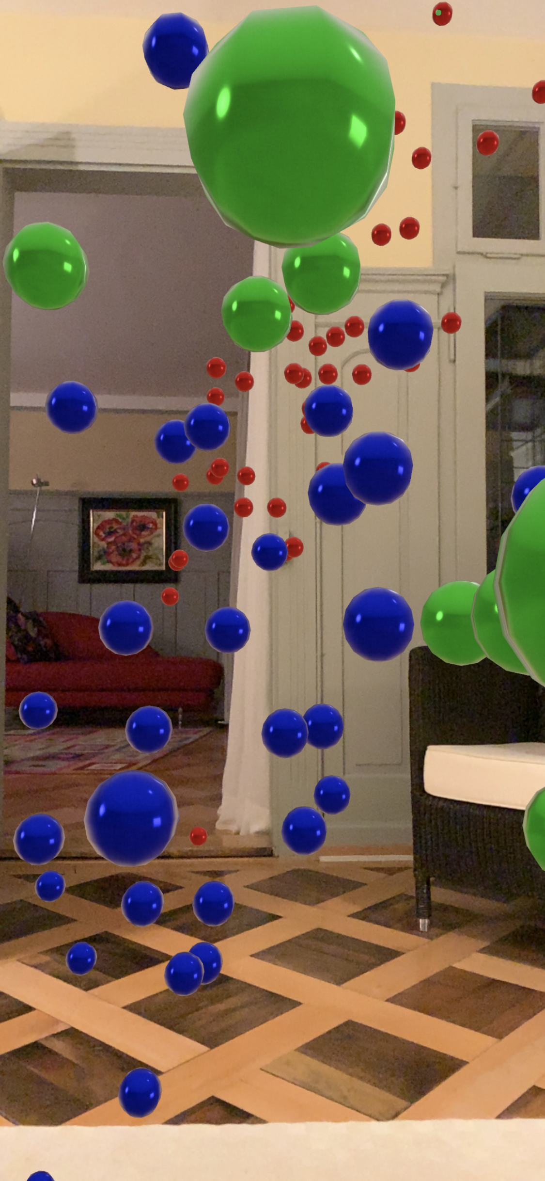
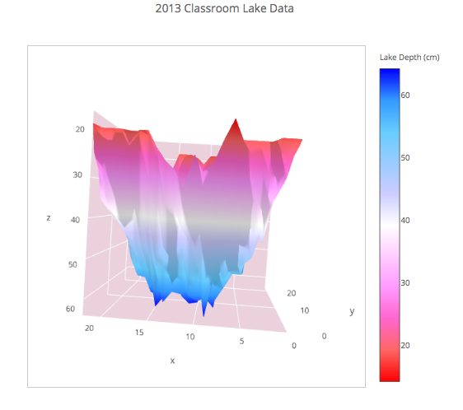
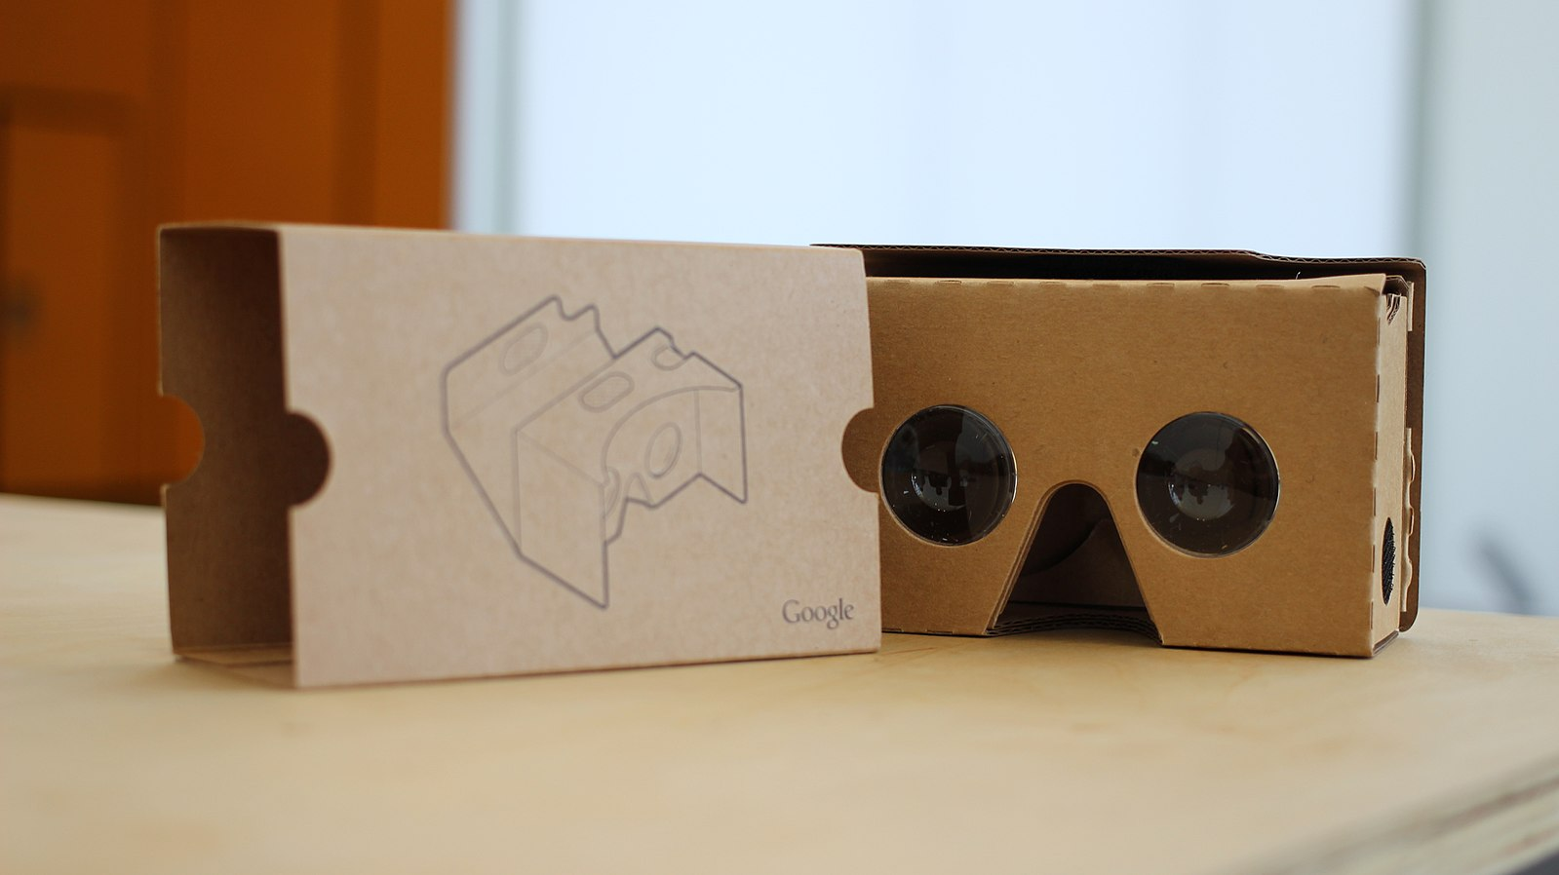
Data Scientists love to visualise...
Not the "real" thing, so
Now and then go 3D
Expensive, meanwhile...

Slide 5
Demo

Slide 6
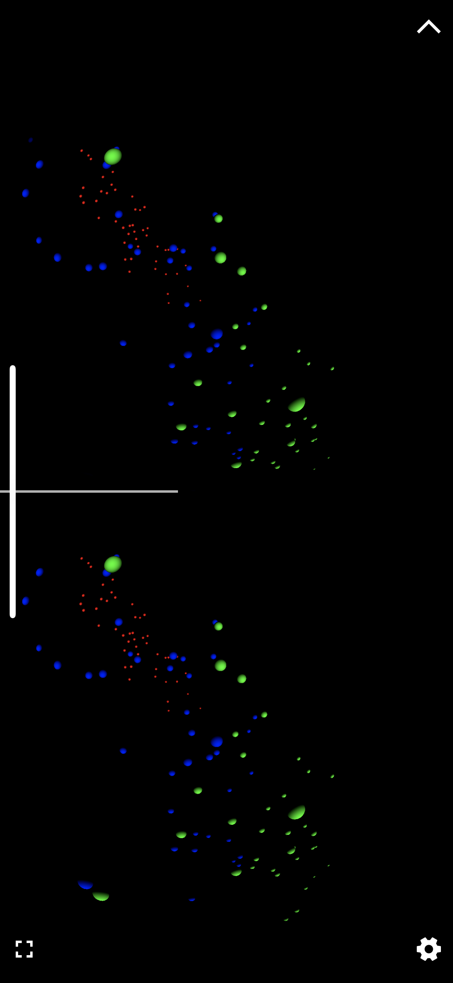
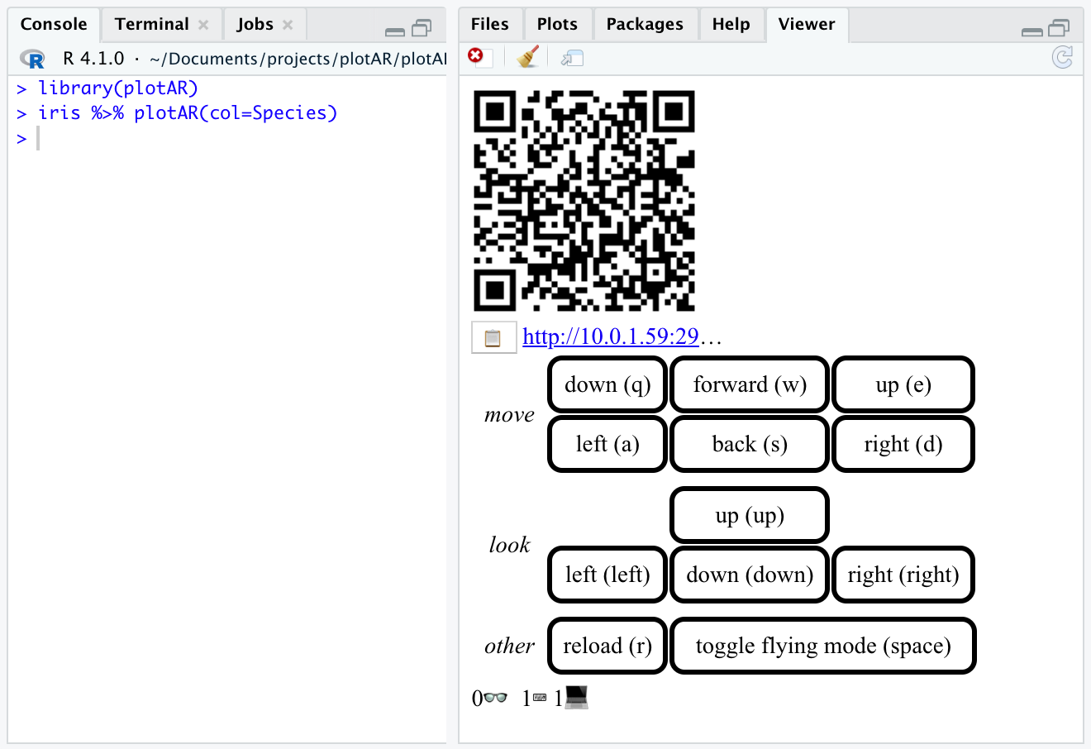
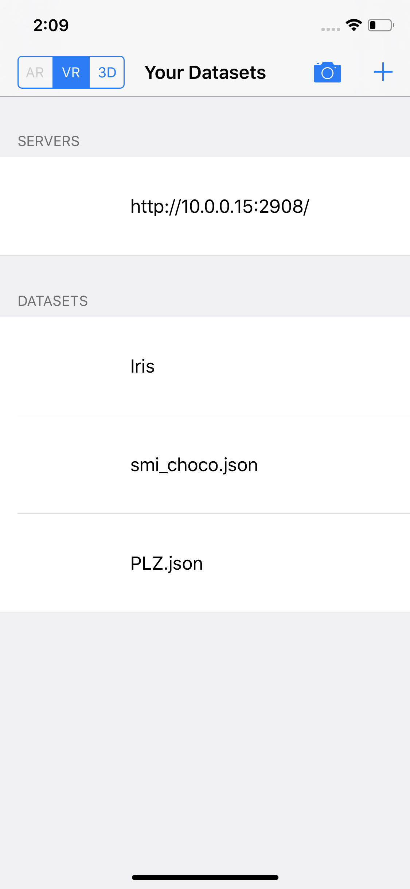
If Demo-Gods are not willing...

Slide 7
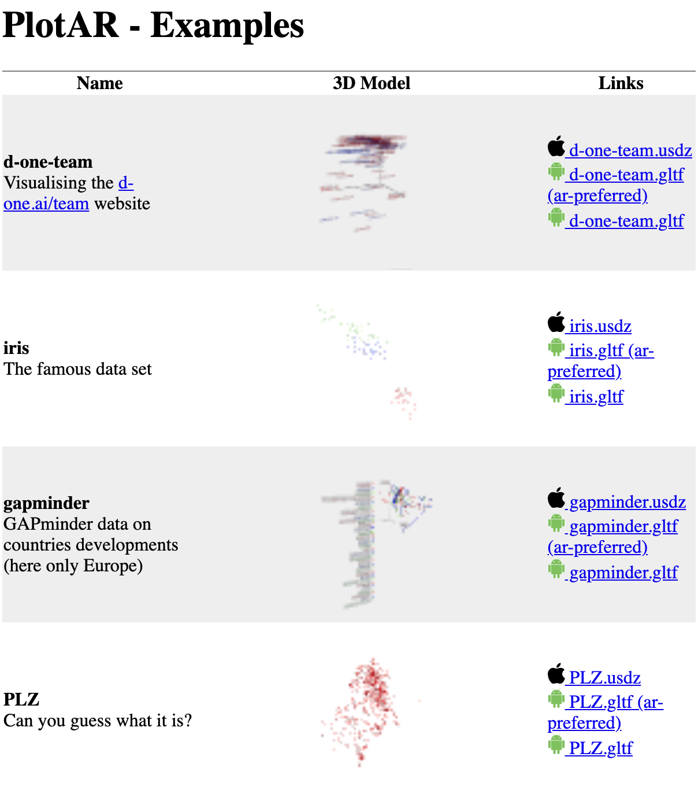
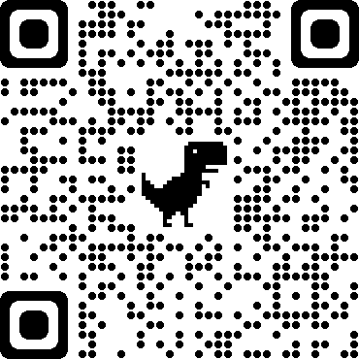
Can I haz plotAR?
Examples on GitHub: https://thomann.github.io/plotAR/examples/
Try it out on Binder:
https://mybinder.org/v2/gh/thomann/plotAR/binder
https://mybinder.org/v2/gh/thomann/plotAR/binder?urlpath=rstudio
R:
devtools::install_github('thomann/plotAR, subdir='plotAR-R')
Python:
pip install plotAR
iOS-App
https://github.com/thomann/PlotAR-ios (needs XCode and a "free personal team")
To have you as an early tester: philipp.thomann@d-one.ai
Android-App:
https://github.com/thomann/plotVR-android
https://github.com/thomann/plotVR-android/releases

Slide 8
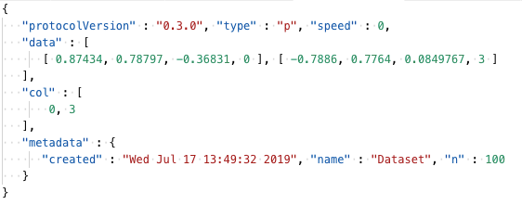
Architecture
data.json:
Desktop
Mobile
Jupyter
plotAR (Swift) +VR
All features
/data.json /ws
<iframe />
Server (Tornado)
Dev Server on localhost:2908
or
handlers in Jupyter
⇒ distribute Jupyter tokens
Browser (iOS)
/data.usd
HTTP-POST:
data
Controller (HTML)
10.0.0.1:2908/keyboard.html
Websocket:
key, status
HTTP-GET: data
Websocket: key, status
Browser (Android)
/data.gltf
HTTP-POST:
data
RStudio
Viewer Pane
plotVR (Android)
(not up to date)
Warning on Dev Server:
All data is transmitted unencrypted and everybody can connect!

Slide 9
Features
User interface
easy to use interface functions
possibility to connect to remote servers (e.g. on mybinder.org)
Rendering engine of plots to 3D-Formats/Frameworks
GLTF by Kronos (OpenGL), supported both in Desktop and Android browsers
USD: by Pixar Studios, supported by iOS (and macOS Preview, XCode, QuickLook)
SceneKit Framework (iOS) and OpenGL (Android) on device rendering
Visuals
Scatter plots with spheres, lines with grouping, surfaces
Colors, sizes as features
Legends, axes with names
Desktop-Mobile interaction - the QR code
Heuristics to find an external IP to connect your mobile device to your desktop or binder server
Support for Jupyter Auth-Token (e.g. on mybinder.org) and embedding it into the QR-Codes
Websockets between server and all devices to send information around e.g. reload the data, how many keyboards or devices are connected, keystrokes

Slide 10
Outlook / Vision
Protocol
Animation !
Return more information from device: viewframe, select on tap?
Send floats as binary Base64 encoded...
interoperability with Plotly Protocol? or with ggplot?
Visuals
scatter point symbols (+, o, …), add rotations, vector fields
Tap on data points to get more info, or to select it and get info on Desktop?
CRAN, AppStore, GooglePlay
Better support to share files
Server:
easy HTTPS setup
Namespaces on server → central plotAR server, e.g. on cloud/premise…
Multiuser Experience: Join the same server, see where the others are, where they are looking at
AR dashboards

Slide 11
LET’S MAKE SENSE
Philipp Thomann
philipp.thomann@d-one.ai
+41 44 435 10 24
D ONE Solutions AG Sihlfeldstrasse 58
CH-8003 Zürich

